Slide 1
























Digital Image Processing Histograms and Point
Operations

Slide 2
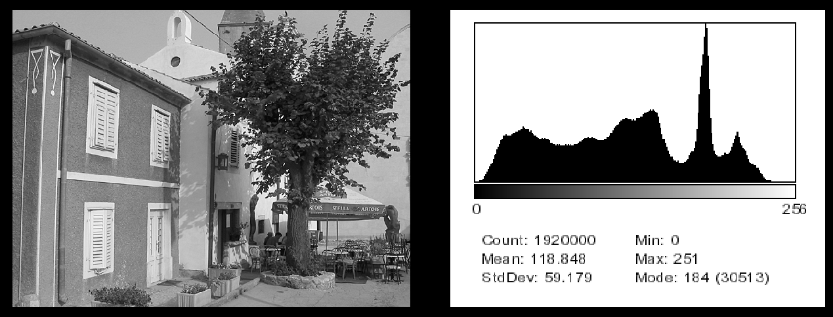
Histograms
Histograms plots how many times (frequency) each intensity value in image occurs
Example:
Image (left) has 256 distinct gray levels (8 bits)
Histogram (right) shows frequency (how many times) each gray level occurs

Slide 3
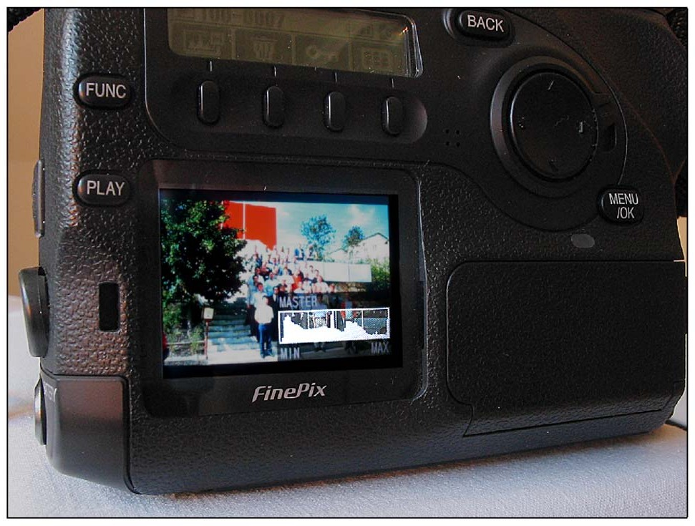
Histograms
Many cameras display real time histograms of scene
Helps avoid taking over‐exposed pictures
Also easier to detect types of processing previously applied to image

Slide 4
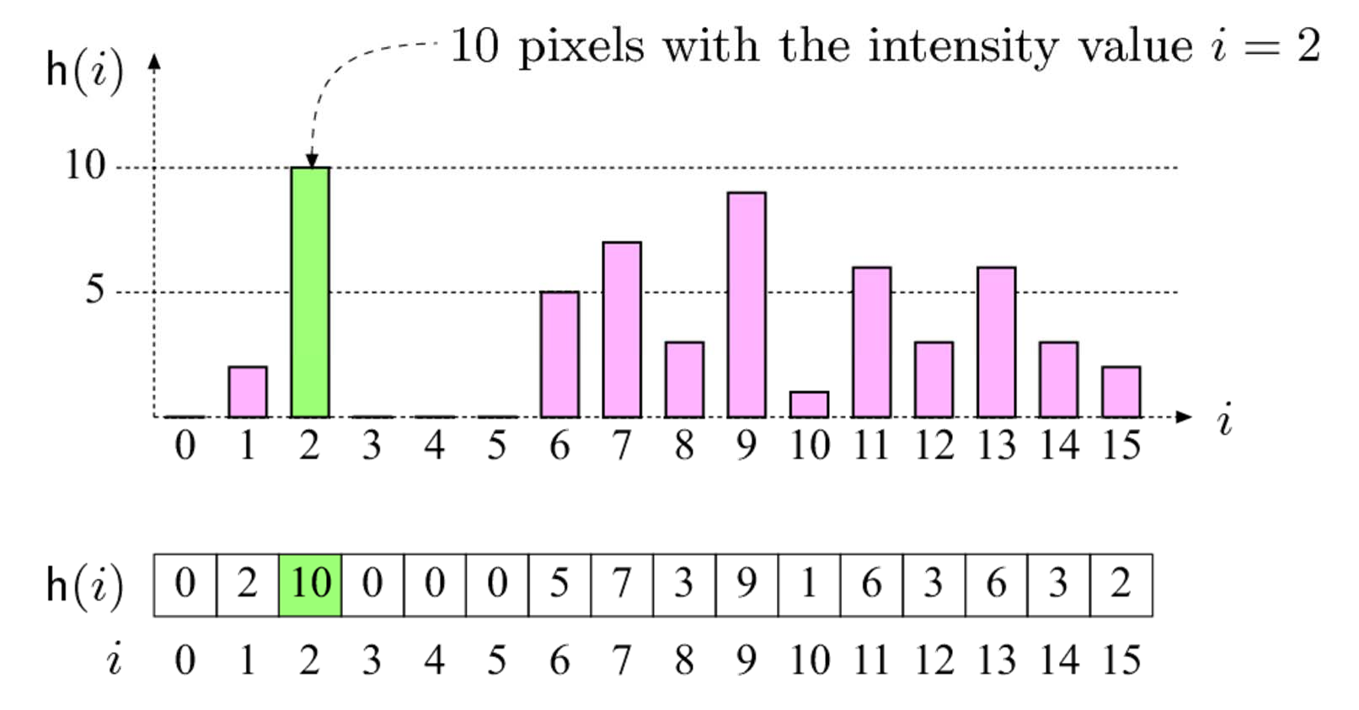
Histograms
Intensity values
E.g. K = 16, 10 pixels have intensity value = 2
Histograms: only statistical information
No indication of location of pixels

Slide 5

Histograms
Different images can have same histogram
3 images below have same histogram
Half of pixels are gray, half are white
Same histogram = same statisics
Distribution of intensities could be different
Can we reconstruct image from histogram? No!

Slide 6
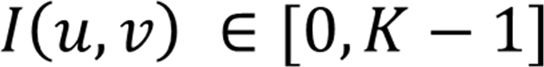
Histograms
So, a histogram for a grayscale image with intensity values in range
would contain exactly K entries
E.g. 8‐bit grayscale image, K = 2⁸ = 256
Each histogram entry is defined as:
h(i) = number of pixels with intensity I for all 0 < i < K.
E.g: h(255) = number of pixels with intensity = 255
Formal definition
Number (size of set) of pixels such that

Slide 7
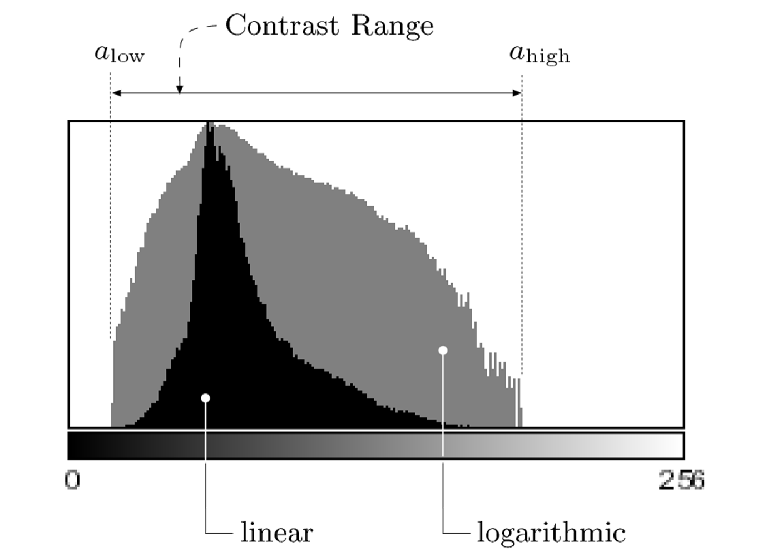
Interpreting Histograms
Log scale makes low values more visible
Difference between darkest and lightest

Slide 8
Histograms
Histograms help detect image acquisition issues
Problems with image can be identified on histogram
Over and under exposure
Brightness
Contrast
Dynamic Range
Point operations can be used to alter histogram. E.g
Addition
Multiplication
Exp and Log
Intensity Windowing (Contrast Modification)

Slide 9
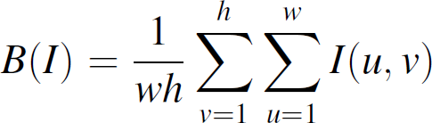
Image Brightness
Brightness of a grayscale image is the average intensity of all pixels in image
2. Divide by total number of pixels
1. Sum up all pixel intensities

Slide 10
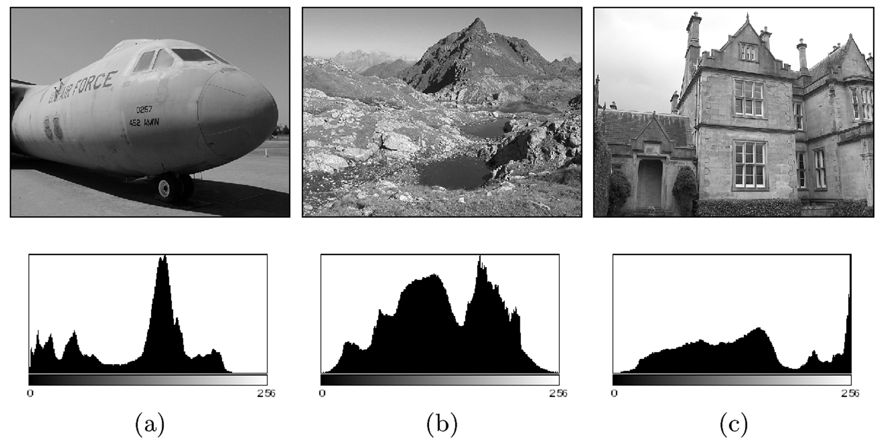
Detecting Bad Exposure using Histograms
Exposure? Are intensity values spread (good) out or bunched up (bad)
Image
Histogram
Underexposed
Properly Exposed
Overexposed

Slide 11
Image Contrast
The contrast of a grayscale image indicates how easily objects in the image can be distinguished
High contrast image: many distinct intensity values
Low contrast: image uses few intensity values

Slide 12
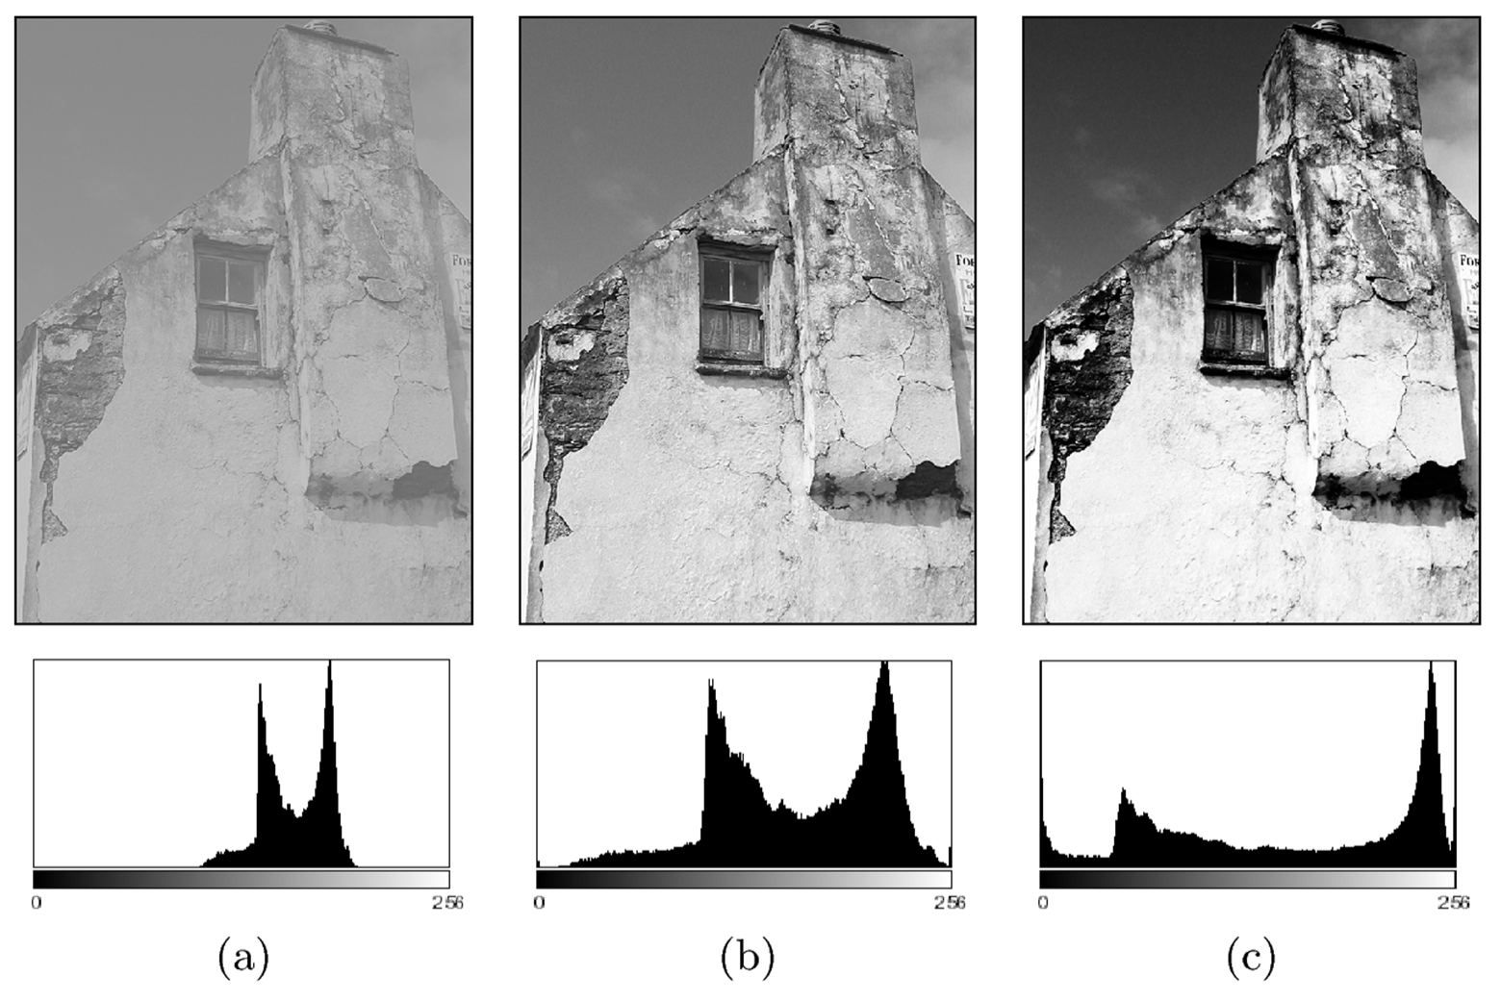
Histograms and Contrast
Good Contrast? Widely spread intensity values
+ large difference between min and max intensity values
Image
Histogram
Low contrast
Normal contrast
High contrast

Slide 13
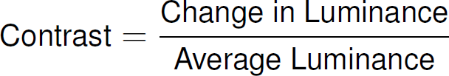
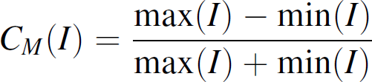
Contrast Equation?
Many different equations for contrast exist
Examples:
Michalson’s equation for contrast

Slide 14
Contrast Equation?
These equations work well for simple images with 2 luminances (i.e. uniform foreground and background)
Does not work well for complex scenes with many luminances or if min and max intensities are small

Slide 15
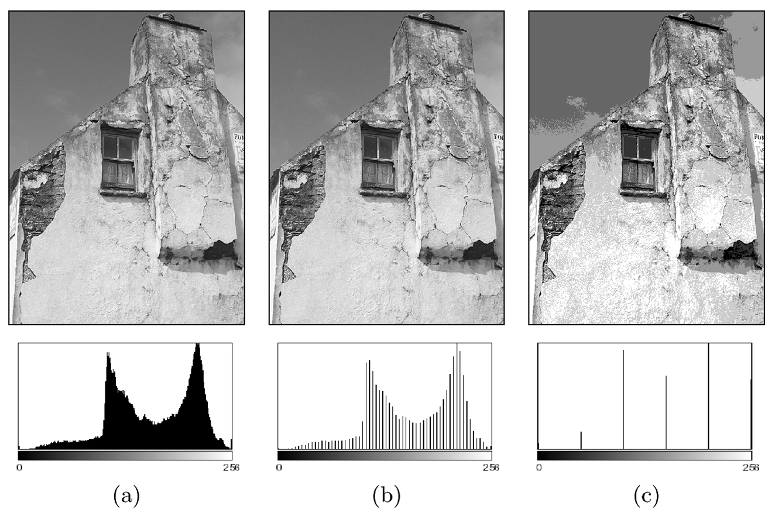
Histograms and Dynamic Range
Dynamic Range: Number of distinct pixels in image
High Dynamic Range
Low Dynamic Range (64 intensities)
Extremely low Dynamic Range
(6 intensity values)
Difficult to increase image dynamic range (e.g. interpolation)
HDR (12‐14 bits) capture typical, then down‐sample

Slide 16
High Dynamic Range Imaging
High dynamic range means very bright and very dark parts in a single image (many distinct values)
Dynamic range in photographed scene may exceed number of available bits to represent pixels
Solution:
Capture multiple images at different exposures
Combine them using image processing

Slide 17
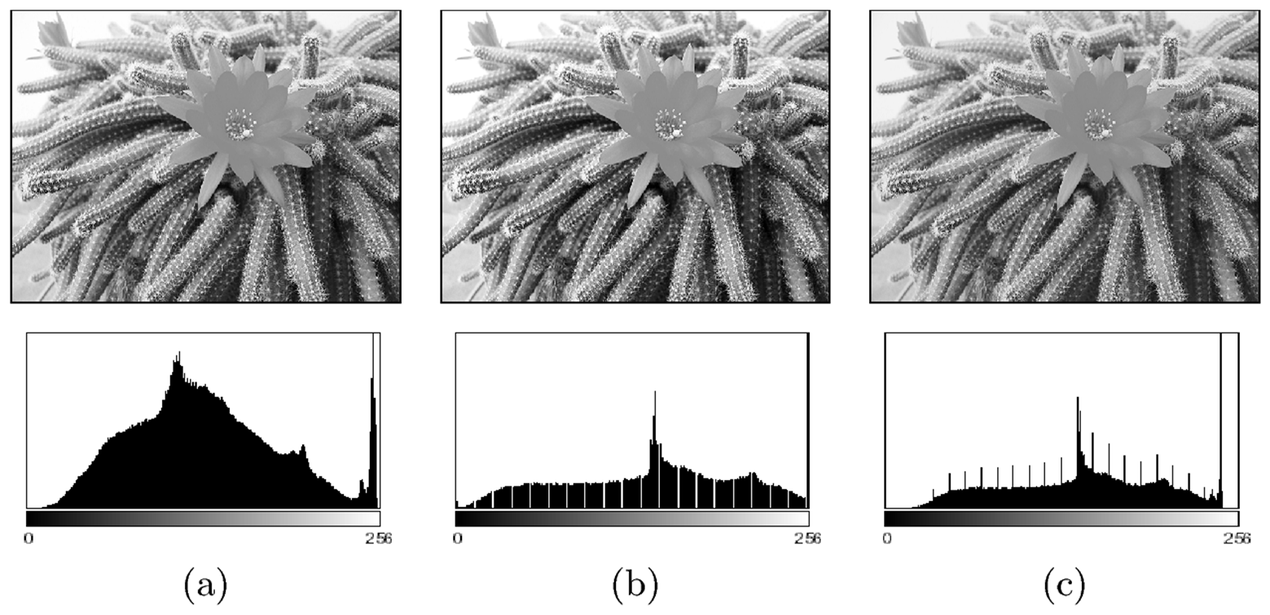
Detecting Image Defects using Histograms
No “best” histogram shape, depends on application
Image defects
Saturation: scene illumination values outside the sensor’s range are set to its min or max values => results in spike at ends of histogram
Spikes and Gaps in manipulated images (not original). Why?

Slide 18
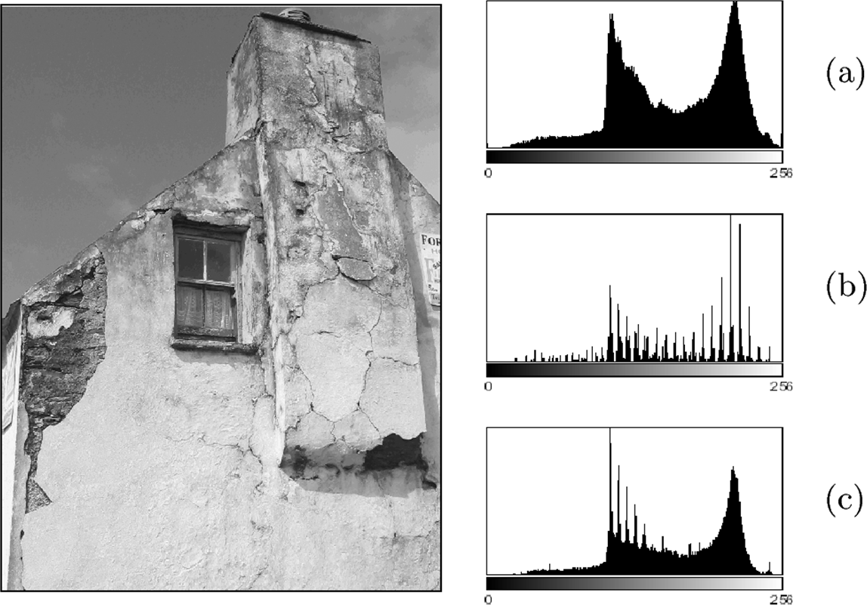
Image Defects: Effect of Image Compression
Histograms show impact of image compression
Example: in GIF compression, dynamic range is reduced to only few intensities (quantization)
Original Histogram
Original Image
Histogram after GIF conversion
Fix? Scaling image by 50% and Interpolating values recreates some lost colors
But GIF artifacts still visible

Slide 19
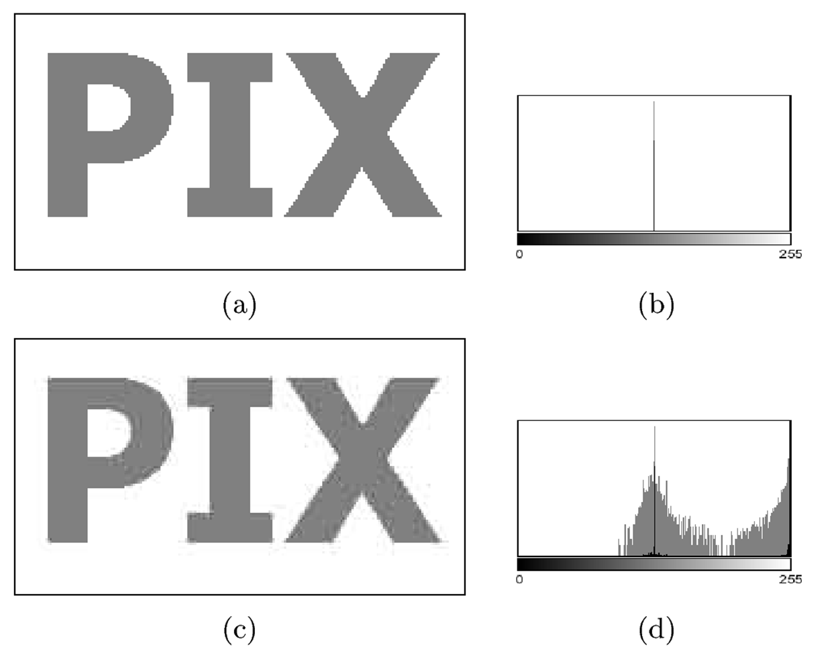
Effect of Image Compression
Example: Effect of JPEG compression on line graphics
JPEG compression designed for color images
Original histogram has only 2 intensities (gray and white)
JPEG image appears dirty, fuzzy and blurred
Its Histogram contains gray values not in original

Slide 20
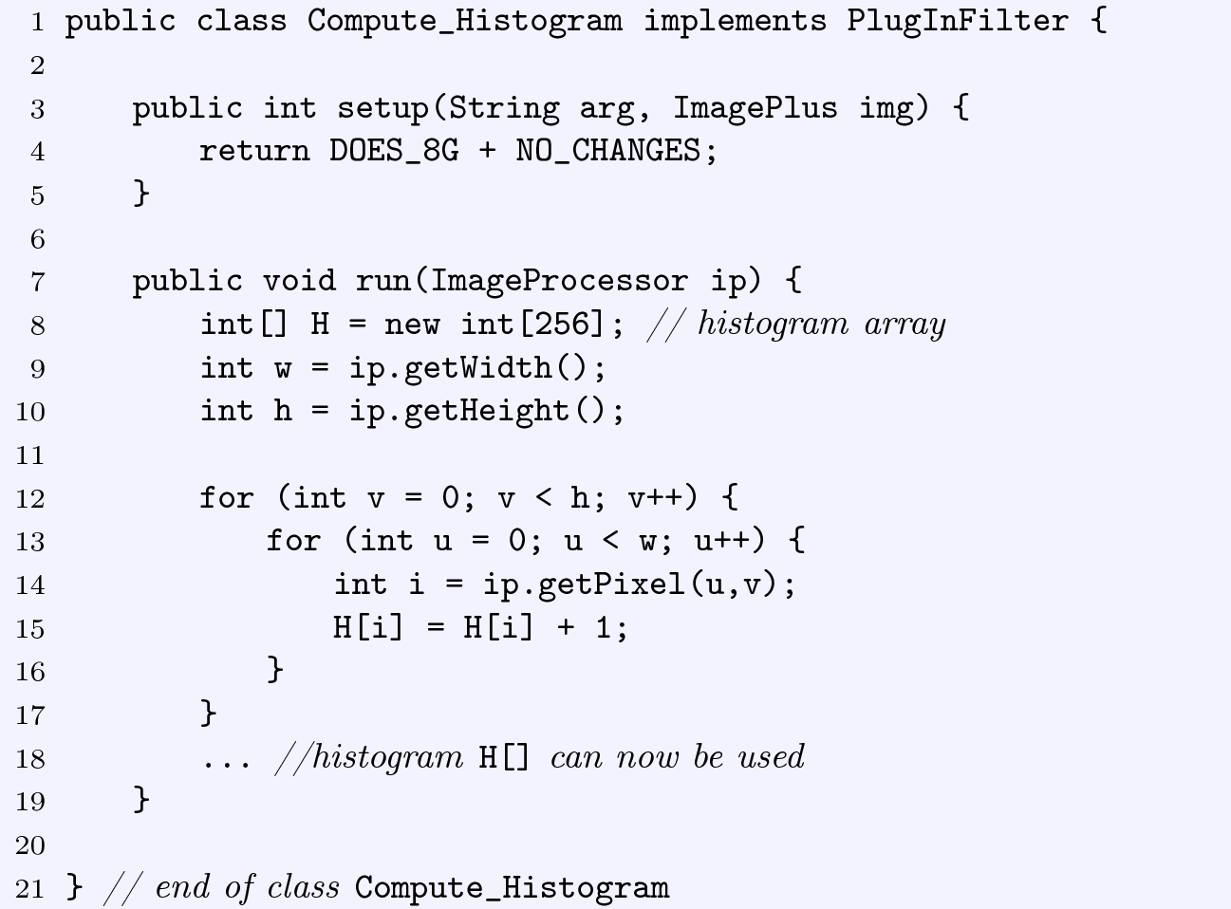
Computing Histograms
Receives 8-bit image, Will not change it
Create array to store histogram computed
Get width and height of image
Iterate through image pixels, add each intensity to appropriate histogram bin

Slide 21
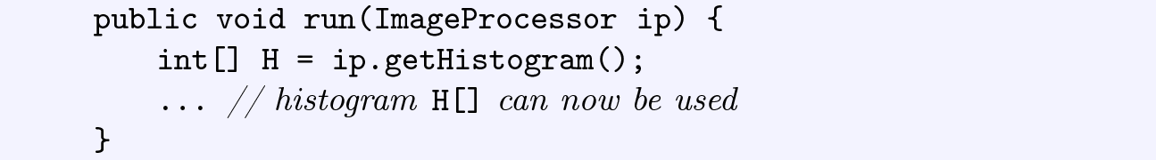
ImageJ Histogram Function
ImageJ has a histogram function ( getHistogram( ) )
Prior program can be simplified if we use it
Returns histogram as an array of integers

Slide 22
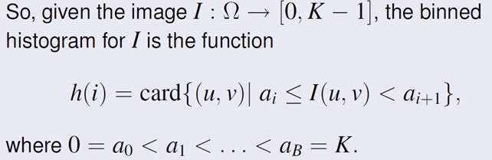
Large Histograms: Binning
High resolution image can yield very large histogram
Example: 32‐bit image = 2³² = 4,294,967,296 columns
Such a large histogram impractical to display
Solution? Binning!
Combine ranges of intensity values into histogram columns
Number (size of set) of pixels
such that
Pixel’s intensity is between a_{i} and a_{i+1}

Slide 23
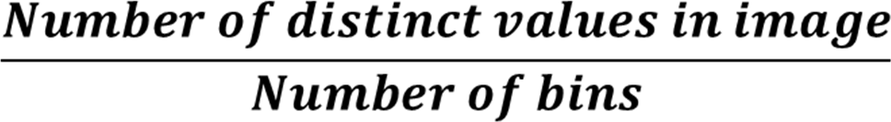
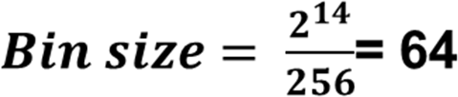
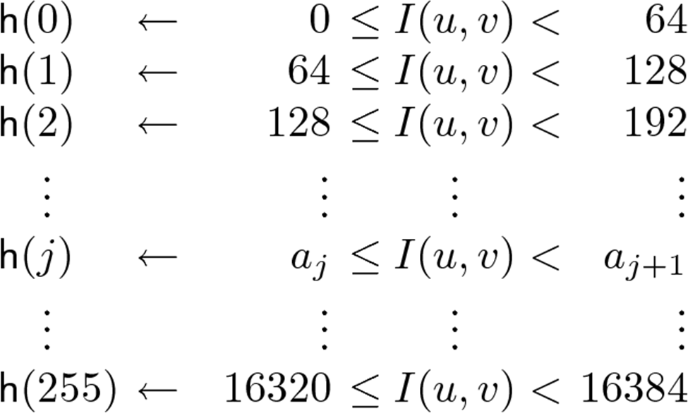
Calculating Bin Size
Typically use equal sized bins
Bin size?
Example: To create 256 bins from 14‐bit image

Slide 24
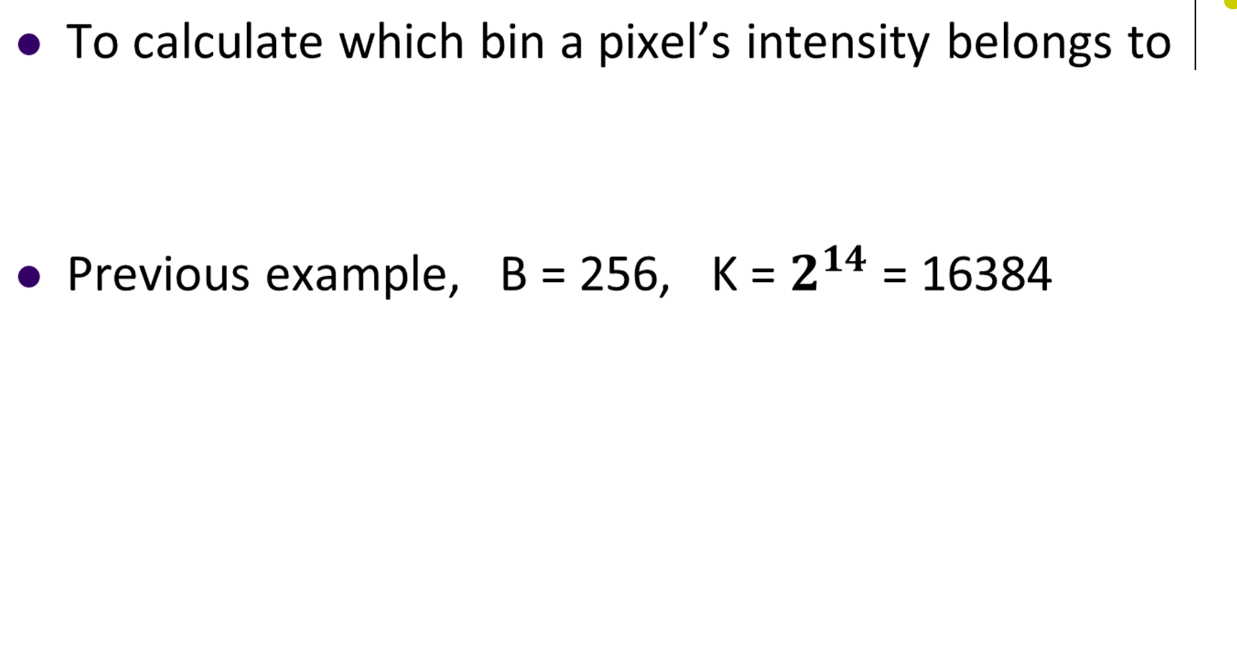
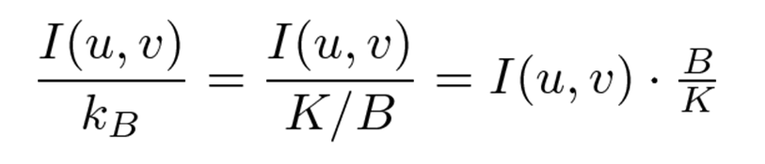
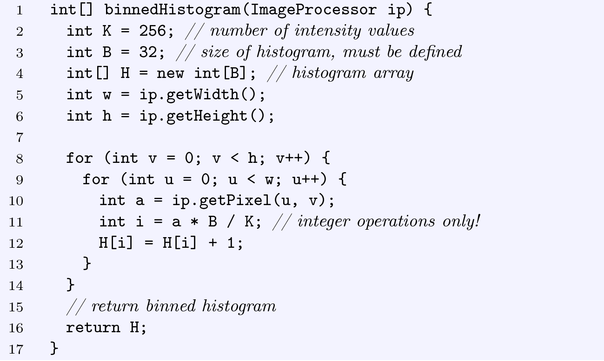
Binned Histogram
●
Create array to store histogram computed
Calculate which bin to add pixel’s intensity
Increment corresponding histogram

Slide 25
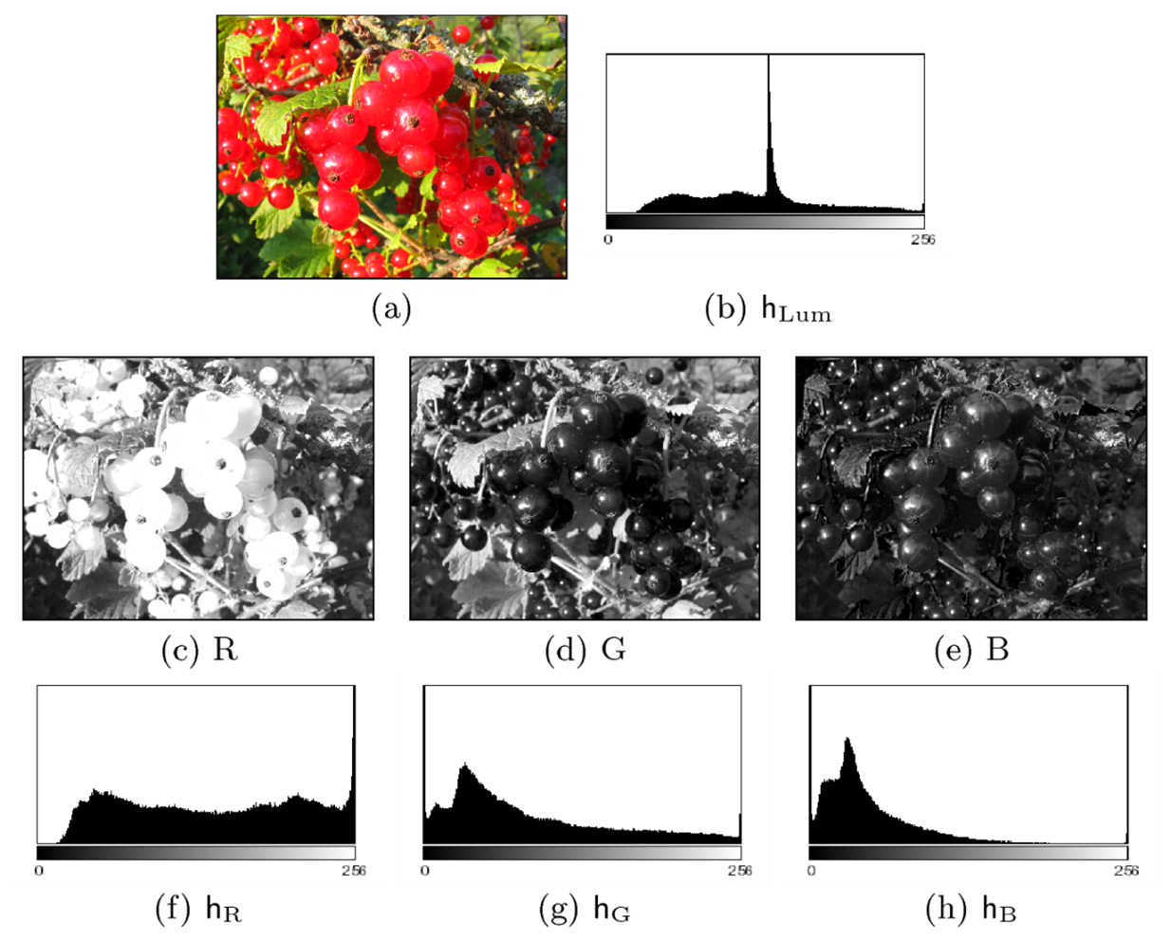
Color Image Histograms
Two types:
Intensity histogram:
Convert color image to gray scale
Display histogram of gray scale
Individual Color Channel Histograms: 3 histograms (R,G,B)

Slide 26
Color Image Histograms
Both types of histograms provide useful information about lighting, contrast, dynamic range and saturation effects
No information about the actual color distribution!
Images with totally different RGB colors can have same R, G and B histograms
Solution to this ambiguity is the Combined Color Histogram.
More on this later

Slide 27
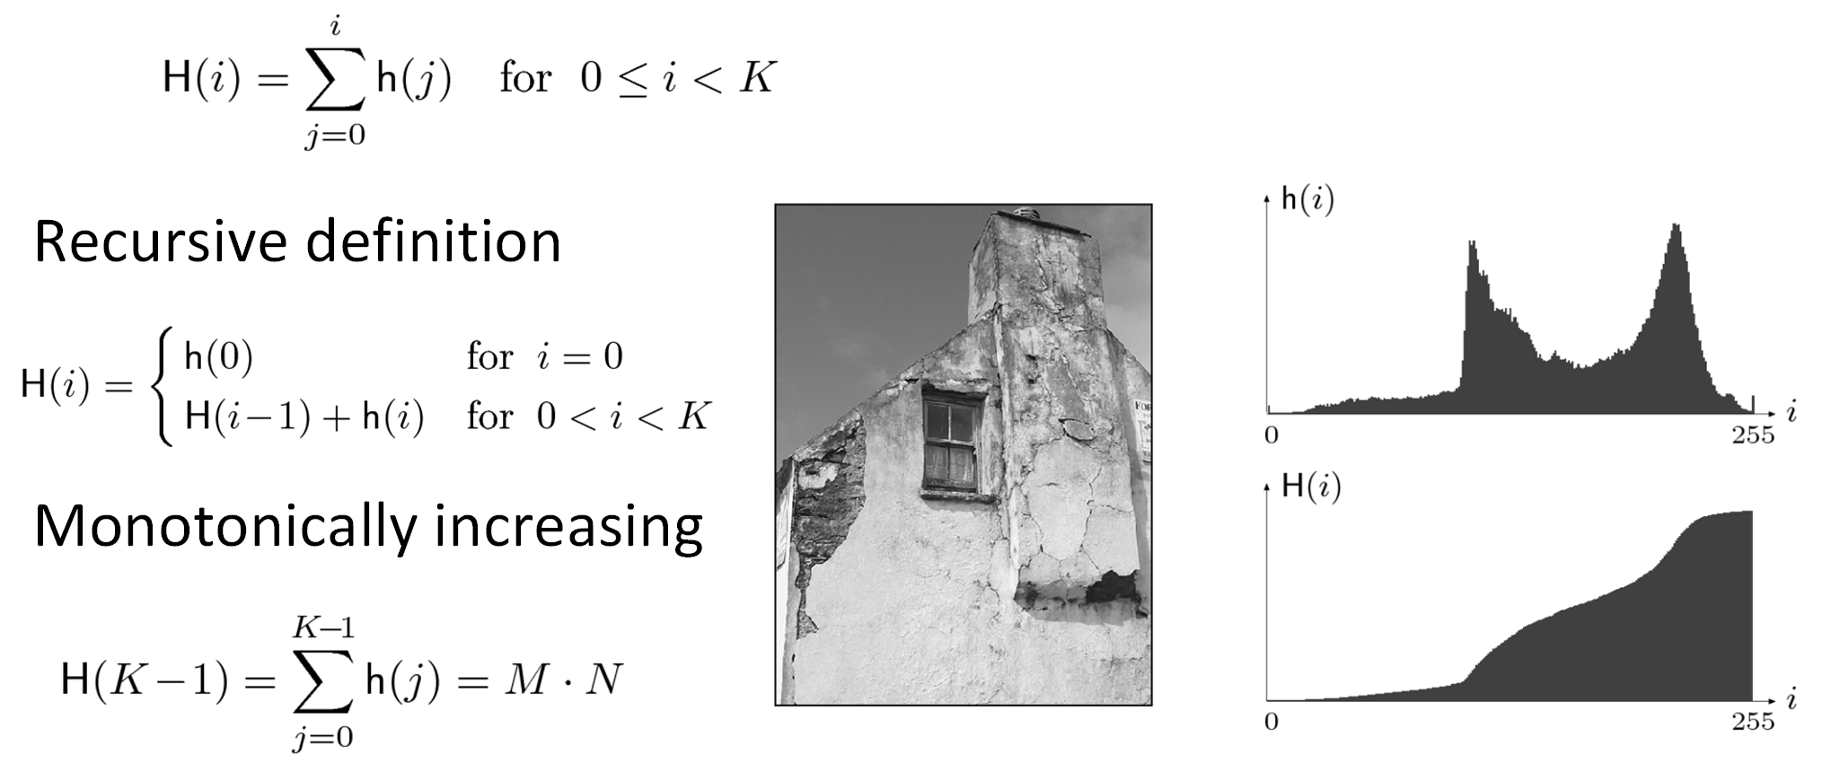
Cumulative Histogram
Useful for certain operations (e.g. histogram equalization) later
Analogous to the Cumulative Density Function (CDF)
Definition:
●
Recursive definition
●
Monotonically increasing
Last entry of Cum. histogram
Total number of pixels in image

Slide 28
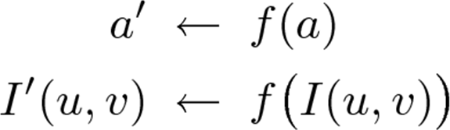
Point Operations
Point operations changes a pixel’s intensity value according to some function (don’t care about pixel’s neighbor)
Also called a homogeneous operation
New pixel intensity depends on
Pixel’s previous intensity I(u,v)
Mapping function f( )
Does not depend on
Pixel’s location (u,v)
Intensities of neighboring pixels

Slide 29
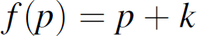
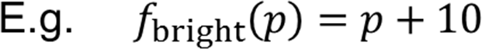
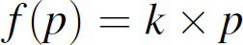
Some Homogeneous Point Operations
Addition (Changes brightness)
Multiplication (Stretches/shrinks image contrast range)
Real‐valued functions
Quantizing pixel values
Global thresholding
Gamma correction

Slide 30
Point Operation Pseudocode
Input: Image with pixel intensities I(u,v) defined on [1 .. w] x [1 .. H]
Output: Image with pixel intensities I’(u,v)
for v = 1 .. h
for u = 1 .. w
set I(u, v) = f (I(u,v))

Slide 31
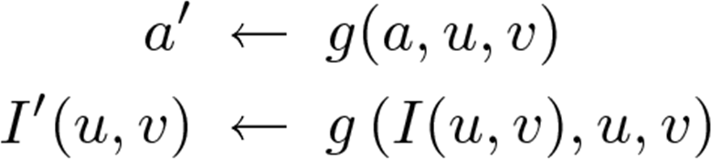
Non‐Homogeneous Point Operation
New pixel value depends on:
Old value + pixel’s location (u,v)

Slide 32
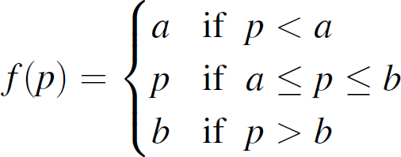
Clamping
Deals with pixel values outside displayable range
If (a > 255) a = 255;
If (a < 0) a = 0;
Function below will clamp (force) all values to fall within range [a,b]

Slide 33
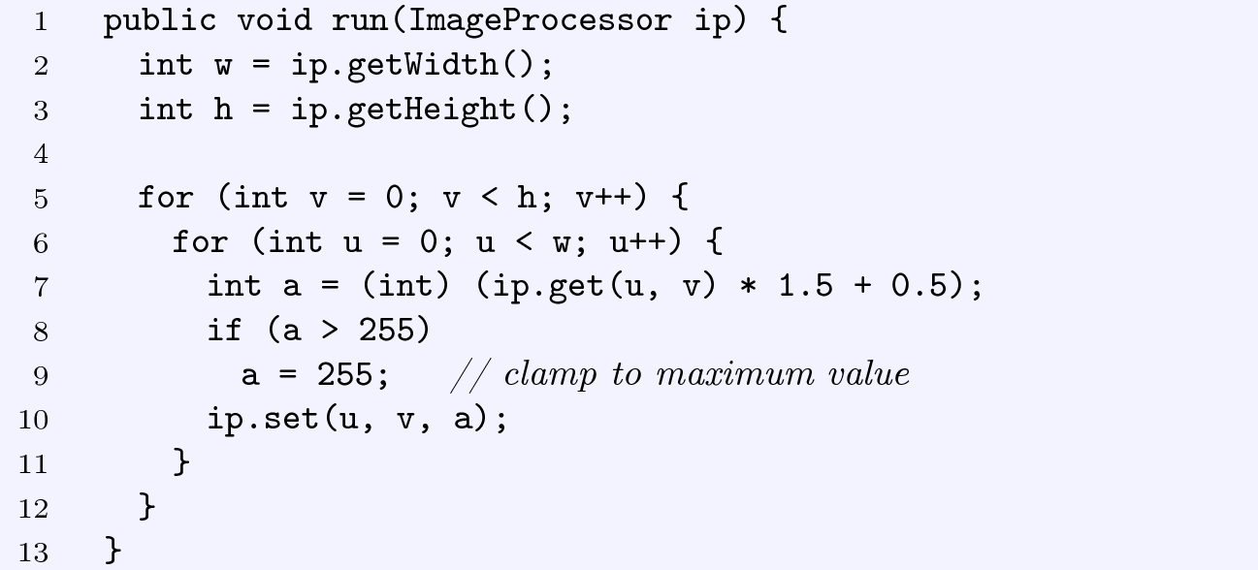
Example: Modify Intensity and Clamp
Point operation: increase image contrast by 50% then clamp values above 255
Increase contrast by 50%

Slide 34
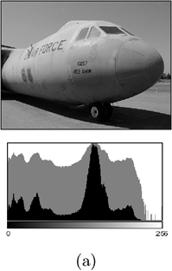
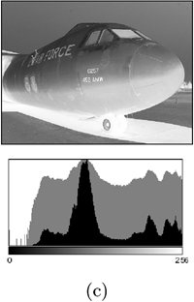
Inverting Images
2 steps
Multiple intensity by ‐1
Add constant (e.g. a_{max}) to put result in range [0,a_{max}]
Implemented as ImageJ method invert( )
Original
Inverted Image

Slide 35
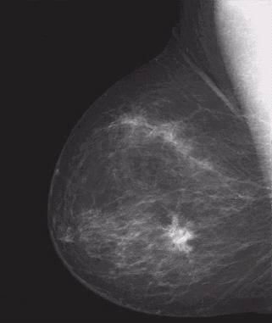
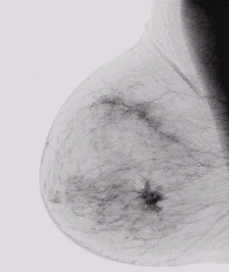

Image Negatives (Inverted Images)
Image negatives useful for enhancing white or grey detail embedded in dark regions of an image
Note how much clearer the tissue is in the negative image of the mammogram below
Images taken from Gonzalez & Woods, Digital Image Processing (2002)
Original Image
s = 1.0 - r
Negative Image

Slide 36
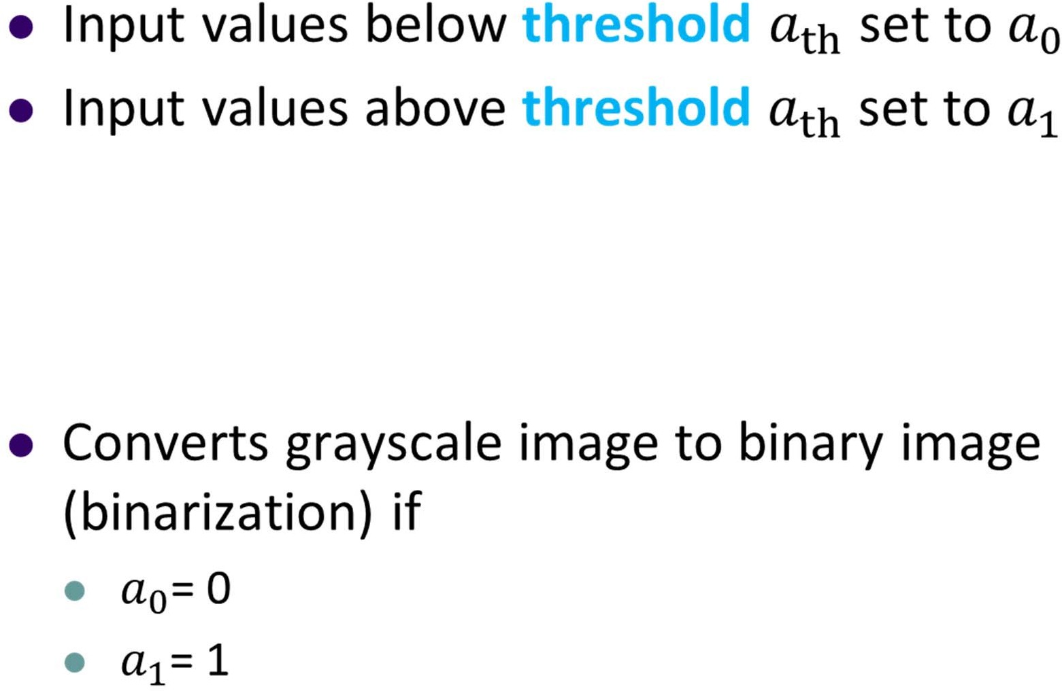
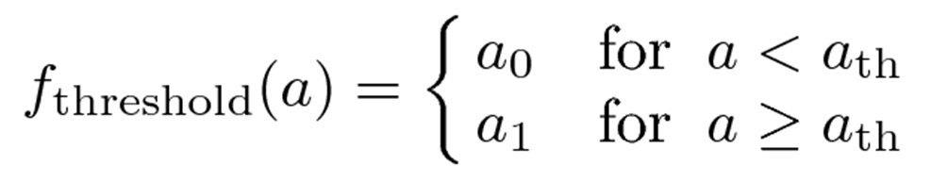
Thresholding
●
Implemented as imageJ method threshold( )

Slide 37
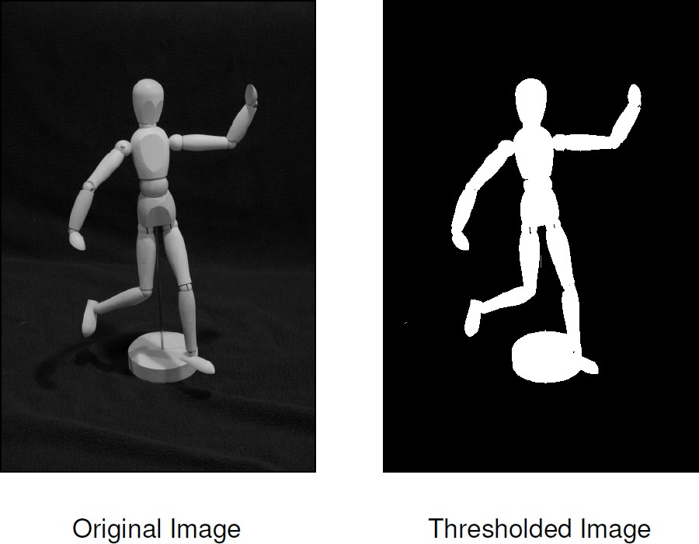
Thresholding Example

Slide 38
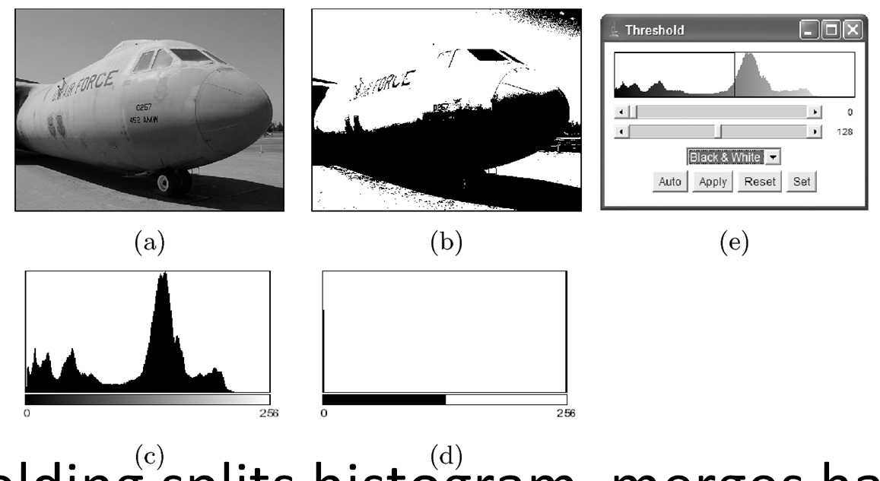
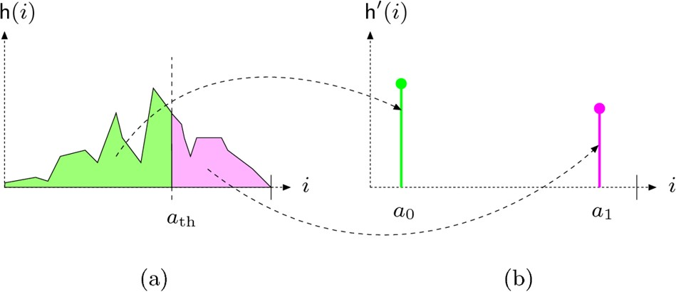
Thresholding and Histograms
Example with a_{th} = 128
Thresholding splits histogram, merges halves into a₀ a₁

Slide 39
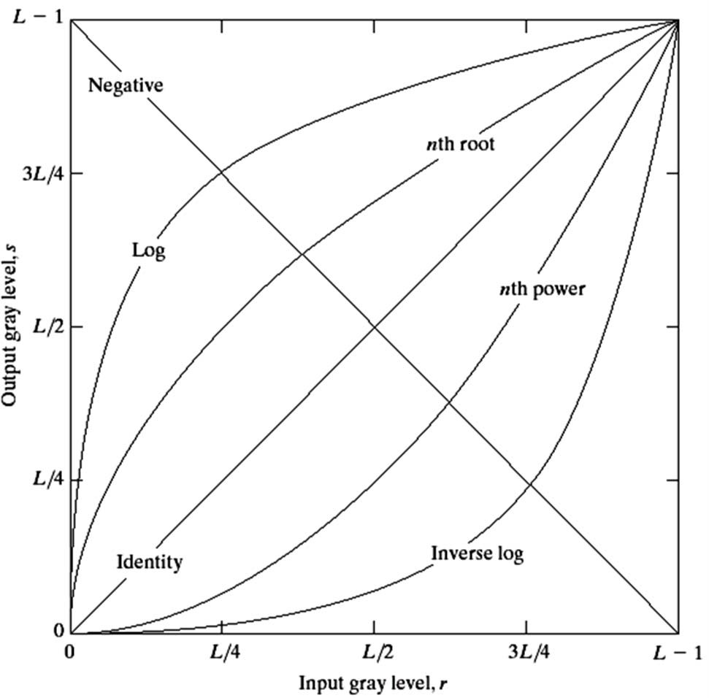

Basic Grey Level Transformations
Images taken from Gonzalez & Woods, Digital Image Processing (2002)
3 most common gray level transformation:
Linear
Negative/Identity
Logarithmic
Log/Inverse log
Power law
n^{th} power/n^{th} root

Slide 40

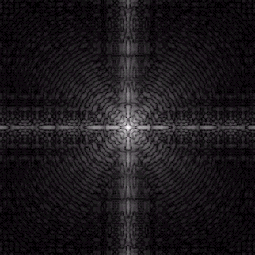
Logarithmic Transformations
Maps narrow range of input levels => wider range of output values
Inverse log transformation does opposite transformation
The general form of the log transformation is
New pixel value
s = c * log(1 + r)
Old pixel value
Log transformation of Fourier transform shows more detail
s = log(1 + r)

Slide 41
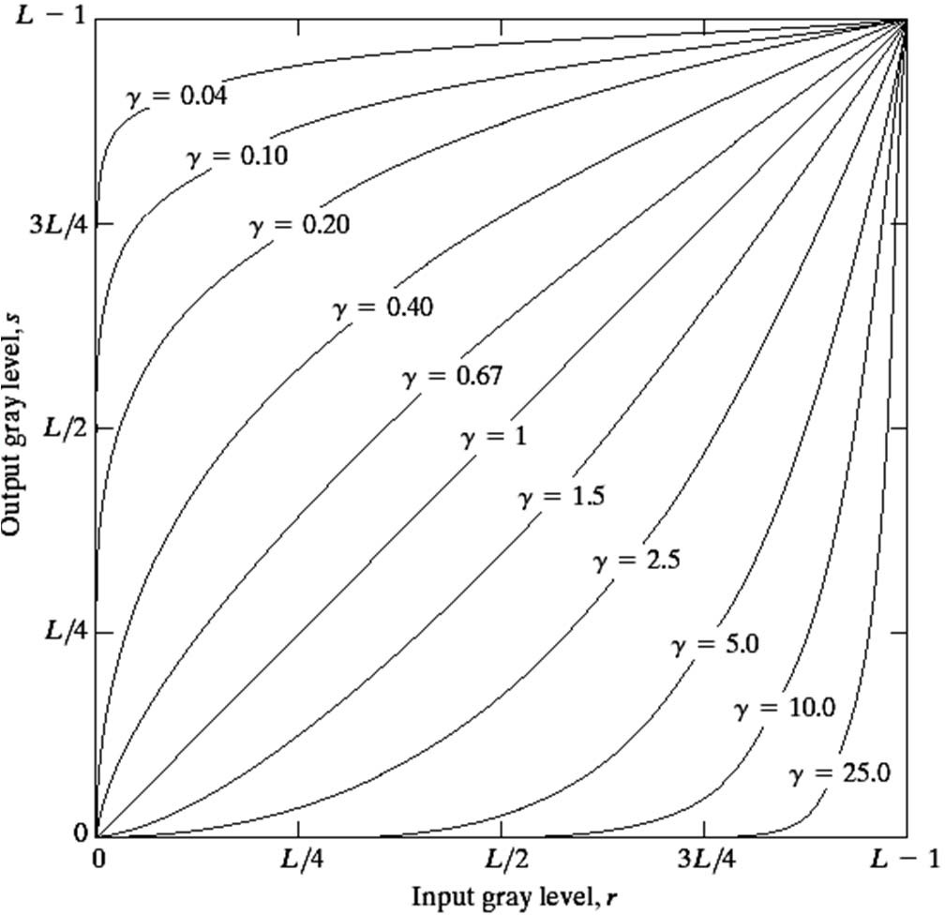
Power Law Transformations
Power law transformations have the form
Images taken from Gonzalez & Woods, Digital Image Processing (2002)
Power
s = c * r ^{γ}
Old pixel value
New pixel value
Constant
Map narrow range of dark input values into wider range of output values or vice versa
Varying γ gives a whole family of curves

Slide 42
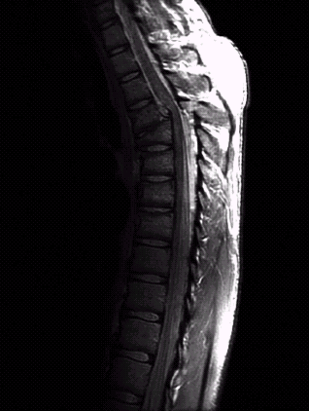
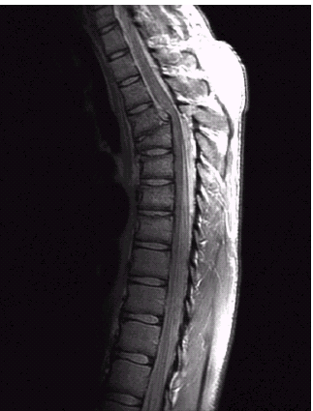

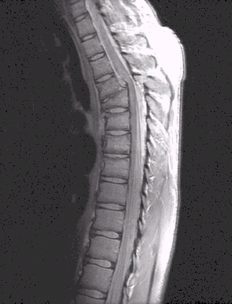
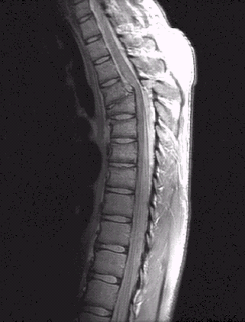
Power Law Example
Original
Images taken from Gonzalez & Woods, Digital Image Processing (2002)
Magnetic Resonance (MR) image of fractured
human spine
_{s = r} 0.6
s = r
Different power values highlight different details
0.4

Slide 43
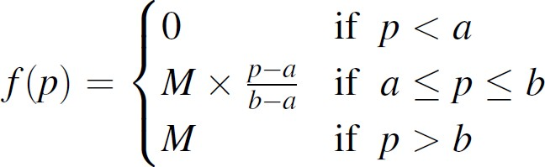
Intensity Windowing
A clamp operation, then linearly stretching image intensities to fill possible range
To window an image in [a,b] with max intensity M

Slide 44
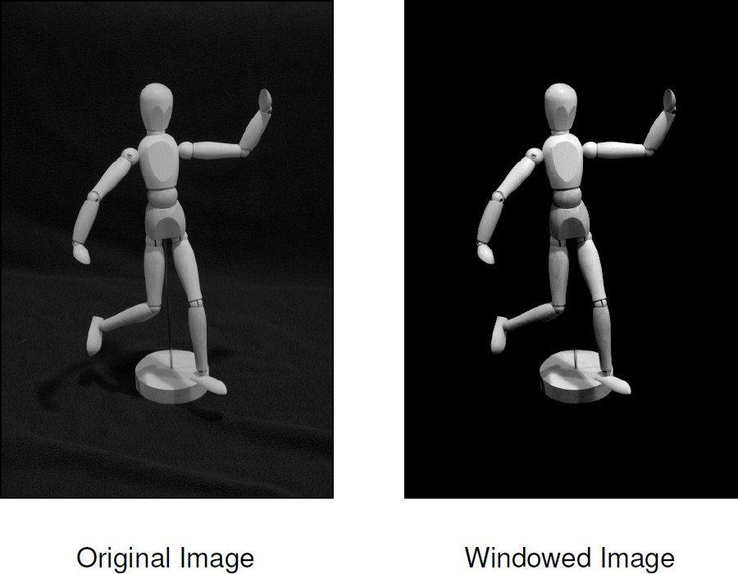
Intensity Windowing Example
Contrasts easier to see

Slide 45

Point Operations and Histograms
Effect of some point operations easier to observe on histograms
Increasing brightness
Raising contrast
Inverting image
Point operations only shift, merge histogram entries
Operations that merge histogram bins are irreversible
Combining histogram operation easier to observe on histogram

Slide 46




Automatic Contrast Adjustment
●
Original intensity range
If a_{min} = 0
and a_{max} = 255
New intensity range

Slide 47

Effects of Automatic Contrast Adjustment
Linearly stretching range causes gaps in histogram
Original
Result of automatic Contrast Adjustment

Slide 48



Modified Contrast Adjustment
●

Slide 49

Histogram Equalization
Adjust 2 different images to make their histograms (intensity distributions) similar
Apply a point operation that changes histogram of modified image into uniform distribution
Histogram
Cumulative Histogram

Slide 50
Histogram Equalization
Spreading out the frequencies in an image (or equalizing the image) is a simple way to improve dark or washed out images
Can be expressed as a transformation of histogram
r_{k}: input intensity
s_{k}: processed intensity
k: the intensity range (e.g 0.0 – 1.0)
processed intensity
s_{k} = T (r_{k} )
input intensity
Intensity range (e.g 0 – 255)

Slide 51



Images taken from Gonzalez & Woods, Digital Image Processing (2002)
Equalization Transformation Function

Slide 52

Equalization Transformation Functions
Images taken from Gonzalez & Woods, Digital Image Processing (2002)
Different equalization function (1‐4) may be used

Slide 53





Images taken from Gonzalez & Woods, Digital Image Processing (2002)
Equalization Examples
1

Slide 54



Images taken from Gonzalez & Woods, Digital Image Processing (2002)
Equalization Examples
2

Slide 55


Images taken from Gonzalez & Woods, Digital Image Processing (2002)
Equalization Examples
4
3

Slide 56
References
Wilhelm Burger and Mark J. Burge, Digital Image Processing, Springer, 2008
Histograms (Ch 4)
Point operations (Ch 5)
University of Utah, CS 4640: Image Processing Basics, Spring 2012
Rutgers University, CS 334, Introduction to Imaging and Multimedia, Fall 2012
Gonzales and Woods, Digital Image Processing (3rd edition), Prentice Hall

